Slide 1
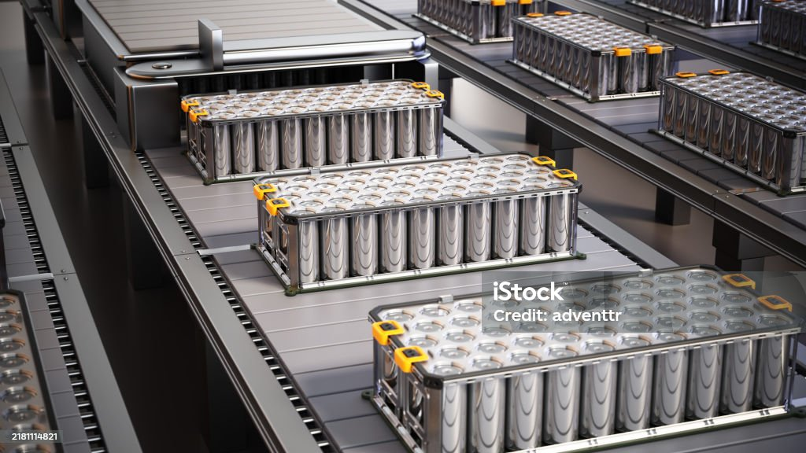
Topic: BATTERY
Presented by:
Kantesh Kumar
Sujal Shah
Surender Kumar
Raj Kumar
Sahil Kumar
Ronak Raja

Slide 2

Introduction to Batteries
A battery is a device that stores chemical energy and converts it into electrical energy. It’s one of the most important inventions in modern technology.

Slide 3
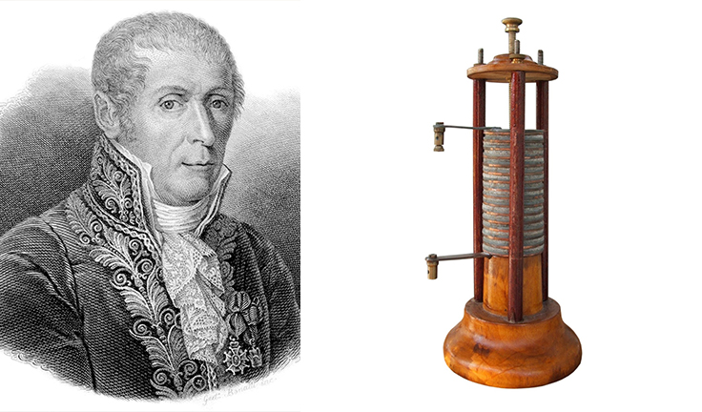
The first battery was made in 1800 by Alessandro Volta.
That’s why we call it the Voltaic pile.
Now we have small, powerful, and rechargeable batteries.

Slide 4
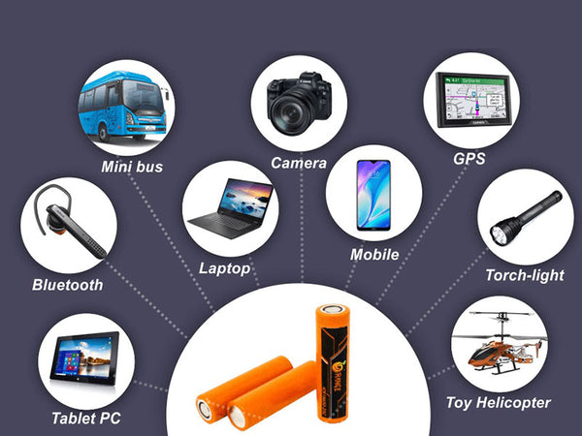
We use batteries in many things. like mobile phones, TV remotes, toys, cars, and even spacecraft.
They help us use devices without being connected to electricity.

Slide 5
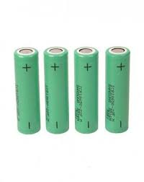
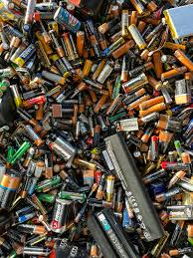
A battery has three main parts:
Anode (negative side)
Cathode (positive side)
Electrolyte (chemical medium)

Slide 6
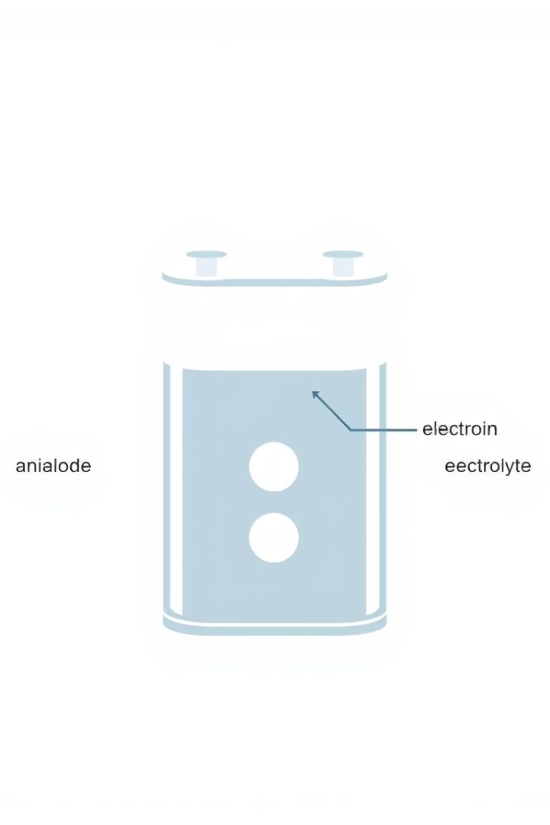
How Batteries Work: The Basics
When you connect a battery to a device, a chemical reaction starts between the anode and cathode through the electrolyte.

Slide 7
These moving electrons create electric current, which powers the device.
So, batteries work by changing chemical energy into electrical energy.

Slide 8
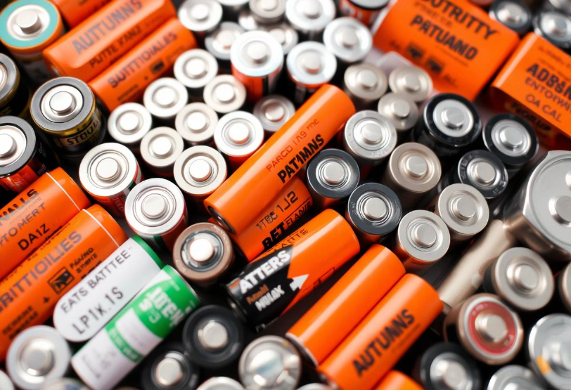
Types of Batteries
Batteries are mainly divided into two categories:
Primary Batteries
Secondary Batteries
Primary Batteries – These are non-rechargeable. Once they are used up, they must be replaced.

Slide 9
Secondary Batteries : These are rechargeable and can be used many times.
Examples:
Lithium-ion batteries (used in smartphones and laptops)
Lead-acid batteries (used in cars)
NiMH (Nickel-metal hydride) batteries (used in digital cameras)
Each battery type has its own advantages and is used for different purposes depending on size, power, and cost.

Slide 10




Secondary Batteries: Rechargeable Power
Lead-Acid
NiCd
Established technology, 25-50 Wh/kg, used in cars and backup power.
Older tech, toxic, 40-60 Wh/kg, common in power tools.
NiMH
Improved NiCd, 60-80 Wh/kg, found in hybrid cars and electronics.
These batteries can be recharged and reused multiple times. They offer diverse applications, from automotive to consumer electronics.

Slide 11

Lithium-Ion Batteries: The Dominant Force
LFP (Lithium Iron Phosphate)
Safer, longer cycle life, preferred for electric vehicles and energy storage systems.
NMC (Nickel Manganese Cobalt)
High energy density, ideal for high-performance EVs and power tools.
Lithium-ion batteries boast high energy density (100-265 Wh/kg) and an excellent cycle life. Various chemistries like LFP, NMC, and NCA are optimized for specific applications, powering electric vehicles, laptops, smartphones, and power tools worldwide.

Slide 15




Solid-State Batteries: The Next Generation
Solid Electrolyte
Liquid electrolytes are replaced with solid materials for enhanced performance.
Enhanced Performance
Potential for 500+ Wh/kg, improved safety, and faster charging speeds.
Overcoming Challenges
Manufacturing scalability and cost reduction are key hurdles for widespread adoption.
Solid-state batteries are poised to revolutionize energy storage. Non-flammable electrolytes significantly improve safety. Leading companies like Toyota, Solid Power, and QuantumScape are at the forefront of this groundbreaking R&D.

Slide 16




Beyond Lithium: Emerging Battery Technologies
Sodium-Ion
Utilizes abundant, cheaper materials.
Aluminum-Ion
Offers high power and fast charging capabilities.
Redox Flow
Highly scalable for large-scale grid storage solutions.
Zinc-Air
Known for high energy density and inherent safety.
The future of batteries extends beyond lithium. Researchers are exploring various promising chemistries. These innovations aim to address cost, sustainability, and specific performance needs for diverse applications.

Slide 17








Battery Applications: Powering Diverse Sectors
Electric Vehicles
Grid Storage
Enabling sustainable transportation globally.
Balancing renewable energy supply on a large scale.
Medical Devices
Consumer Electronics
Critical for life-saving and portable medical equipment.
Powering personal devices like smartphones and laptops.
Batteries are integral to numerous sectors. They drive the transition to sustainable energy, enhance mobility, and support critical infrastructure. Their versatility makes them indispensable for modern society.

Slide 18




Challenges and Limitations
Supply Chain
1
Vulnerabilities exist for crucial raw materials like lithium and cobalt.
Degradation
2
Battery lifespan and performance can degrade over time.
Charging
3
Long charging times hinder wider EV adoption.
Energy Density
4
Limits driving range and overall device performance.
Despite advancements, batteries face significant hurdles. Addressing these challenges is crucial for unlocking their full potential and expanding their applications. Continuous innovation is essential for overcoming these limitations.

Slide 19





The Future of Batteries: Innovation and Sustainability
Materials Science
Breakthroughs are expected for higher energy density and performance.
Manufacturing
Advanced techniques will drive down production costs.
Sustainability
Recycling and circular economy initiatives will become standard.
Collaboration
Government and industry partnerships will accelerate innovation.
The future of batteries is bright, driven by relentless innovation. Sustainable practices and collaborative efforts will ensure a robust and environmentally responsible energy storage ecosystem. These advancements promise a more powerful and cleaner tomorrow.

